Slide 1


SAP UI5 & FIORI with OData TRAINING
Anubhav Oberoy & Shekhar Vedi
Day – 8

Slide 2

Agenda – Day 8
Fiori Introduction
Fiori App Structure
Creating Component JS
Working with Multiple Views
Navigation between views
Introduction to manifest.json
Understanding the structure of manifest.json

Slide 3
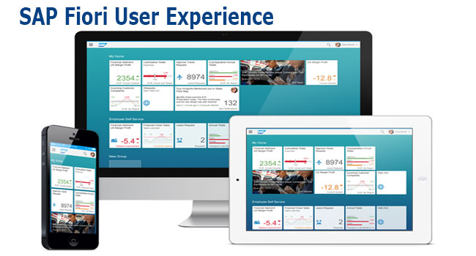
What is Fiori?
SAP Fiori is the user interface or user experience (UX) that supplements and can replace the SAP GUI. This streamlined application uses tiles to encapsulate standard tasks, such as approving purchase requisitions, viewing sales orders, and approving timesheets.
Fiori is SAP’s new user experience. These are standard apps delivered by SAP and by following the Development guidelines any one can use UI5 to create Fiori Apps.
Fiori is a streamlined application, delivering a role-based user experience that can be personalized across all lines of business, tasks and devices.
It uses tiles to encapsulate standard tasks like viewing sales orders or approving timesheets.
Fiori = UI5 + Development/Design Guidelines

Slide 4
Structure of a Fiori project
There are different folders and directory are required for setup project: webapp, Controller, models, utils ,view, Component.js, manifest.json, index.html
Structure of normal ui5 application
Index.html
View
Controller
Structure of Fiori Application
Dev.
sap/ui/core/UIComponent
Index.html
Root View
App.view.xml
Component.js
View 1
Controller 1
Container
App (pages)
View 2
Controller 2
manifest.json
App descriptor
App.controller.js
BaseController
Component.js is starting point

Slide 5
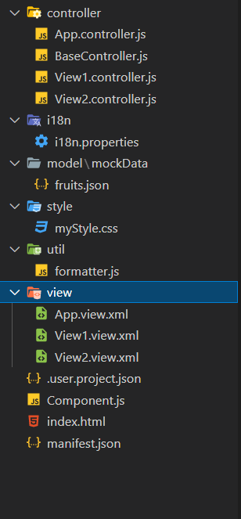
Structure of Fiori Project Files
There are different folders and directory are required for setup project
Webapp = This provides the root directory and of all files given in alias name or namespace
Controller = The controller folder contains all the controllers used by your views and might also contain additional logic files that are used by one or more controllers. The structure of the controller folder should mirror the view folder.
models = It contains .json file and object of data
utils = It is the reuse file of JS code
view = It contains all the .xml files.
Component.js = It is the starting file of our app
manifest.json = It is the application descriptor file.
Index.html

Slide 6
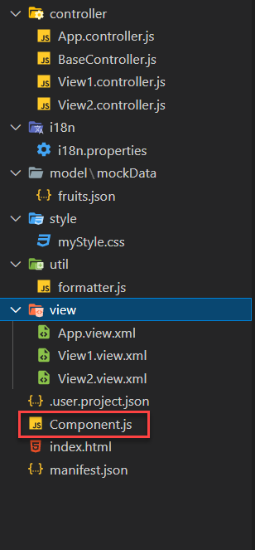
What is Component.js
Component.js the starting point of ANY Fiori app. If an app has Component.js inside, it called Fiori like app.
The Component.js file is the component controller and provides the runtime metadata and the component methods.
It is the wrapper of all the functionality. We never start any productive code in index.html, rather its all kept in Component.js
It is a class which inherits from sap/ui/core/UIComponent standard class. We inherit to reuse the functionality offered by SAP like routing.
When app starts, UI5 framework will scan your project’s base directory to check if it has a file with exact name Component.js
The component file calls the manifest file, and we keep all app level configuration inside the manifest file.
It is also important from the point of view that we will instantiate all models for our application inside the manifest file. The model instantiated in manifest file are directly set on the component and not on the root view.

Slide 7
Skeleton of Component.js
The Component.js is consists of 4 sections
metadata
init()
destroy()
createContent()
The metadata section. It has property key manifest and value json. This property calls the manifest.json file which is also know as the app descriptor file. It holds all app level configuration and helps keep our Component file clean thereby clearly separating application coding from configuration settings.
Another section of component file is the init function that is called when the component is initialized. When the component is instantiated, the init function is automatically invoked.
sap.ui.define([
'sap/ui/core/UIComponent'
], function(UIComponent) {
'use strict';
return UIComponent.extend("anubhav.app.Component",{
metadata: {},
init: function(){
},
createContent: function(){
},
destroy: function(){
}
});
});

Slide 8

Exercise
In this exercise we will create a new project folder, in that folder we will add new ui5 project with an App view and a View1, and we will add a Component folder in the webapp folder.
Exercise code/resource:
firstfioriapp
webapp
controller
App.controller.js
BaseController.js
View1.controller.js
view
App.view.xml
View1.view.xml
Component.js
index.html
manifest.json

Slide 9
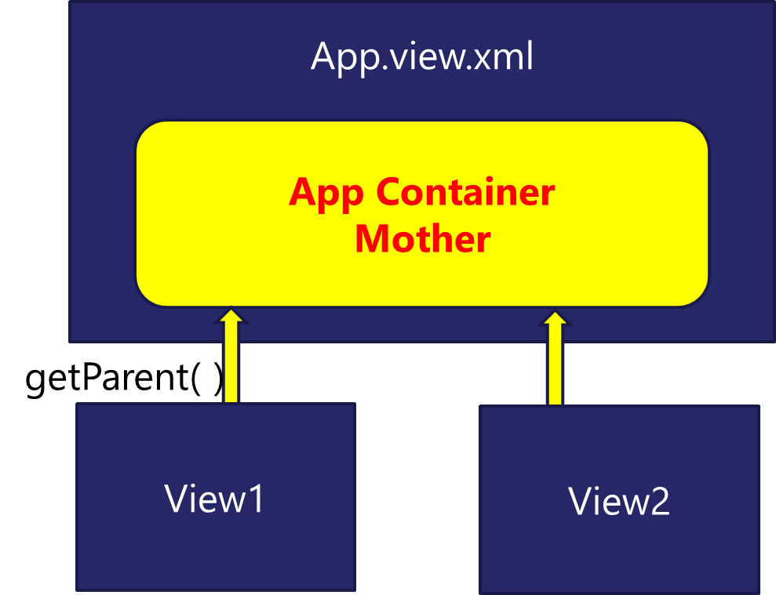
Working with multiple views in Fiori
Most of the Fiori app developed in the industry used to have more than one view. To work with multiple views, we use the concept of Parent View in the Fiori application. Which means all the views are loaded in one Parent View(App View) which then calls the view we want to display to the user.

Slide 10

Exercise
In this exercise we will add a New view in our existing application and will add button to our View1 to navigate to the View2.
Exercise code/resource:-
View1.view.xml
View1.controller.js
View2.view.xml
View2.controller.js
Component.js

Slide 11
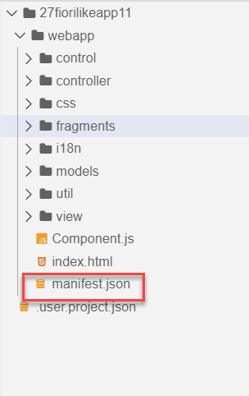
Concept of manifest.json in UI5
manifest.json is also knows as application descriptor file. It contains all the configuration for our app centrally.
Some attributes in the descriptor are just for information purposes, such as the minimum OpenUI5 version (minUI5version), others help external components (for example the SAP Fiori launchpad (FLP)) to integrate the application correctly, but most of the attributes are actually used to configure specific aspects of the app that are needed frequently.
It is written in JavaScript Object Notation (JSON) format.
We recommend that you use the manifest.json file to configure the app settings and put
all important information needed to run the app in there. Using this approach means
you need to write less application code, and you can already access the information
before the app is instantiated.
Everything which is needed for an app to start, load, move, run, configure,
requires is inside manifest.json.

Slide 12
Three Sections of manifest.json
sap.ui5 contains different components
rootView, dependencies, contentDensities, models, routing etc.
sap.ui5
sap.app contains idtype, i18n, applicationVersion, title, description, dataSources.
sap.app
sap.ui contains technology, icons, deviceTypes, supportedThemes
sap.ui

Slide 13

End of Day 8

Slide 14

Questions

Slide 15

Anubhav Oberoy

Slide 16


We’re committed to empower you to be
Most Desirable Resource
through powerful training solutions.
We build the workforce of the future.
250+
Corporate Clients
30,000+
Learners Trained
25000+
Learners Placed
FREE WEBINARS
Sign up for free webinars with industry experts every fortnight!
Enroll Now!
Contact us today!
https://anubhavtrainings.com/

Slide 17




More from AnubhavTrainings.com

Slide 18
Title
Content

